Slide 1
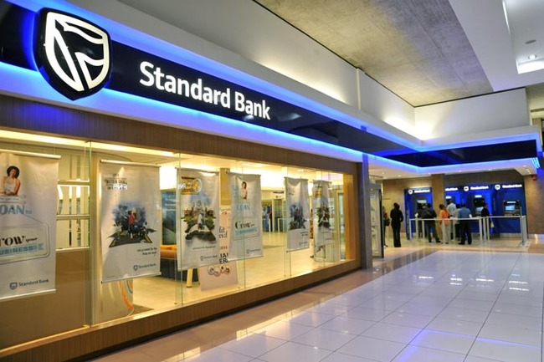

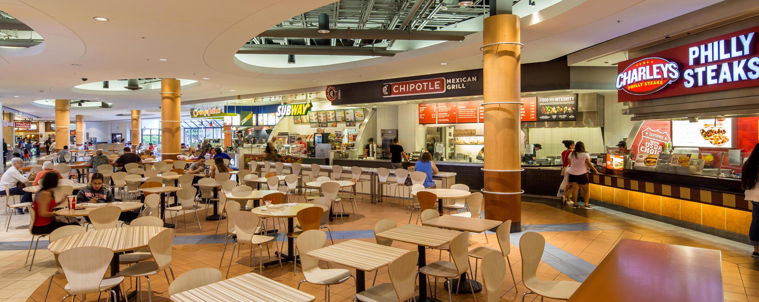
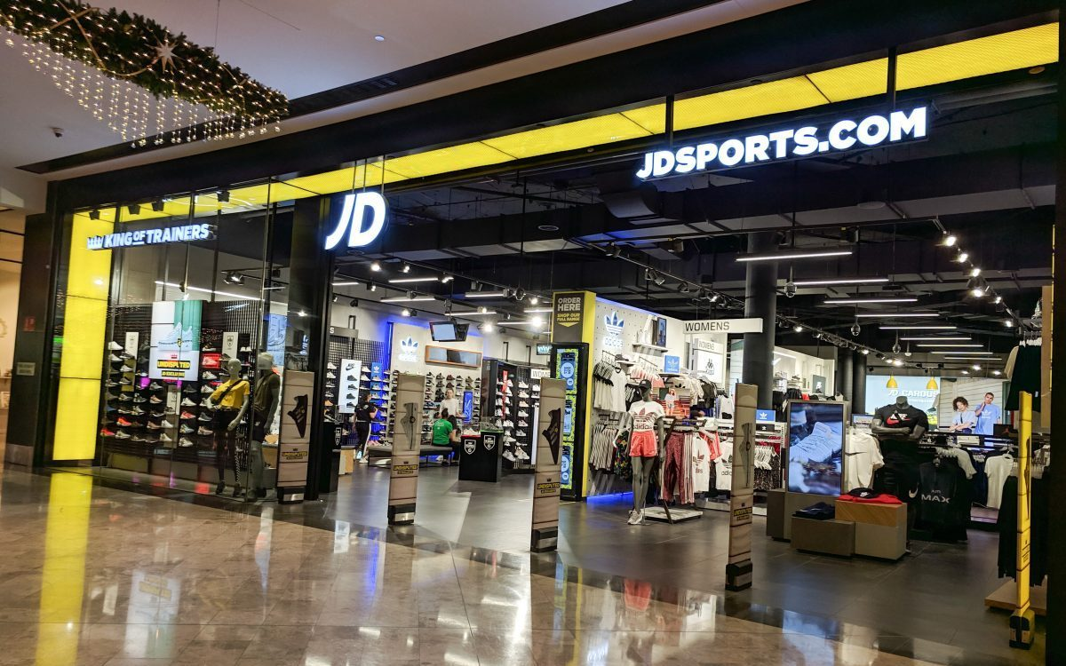





Slide 2

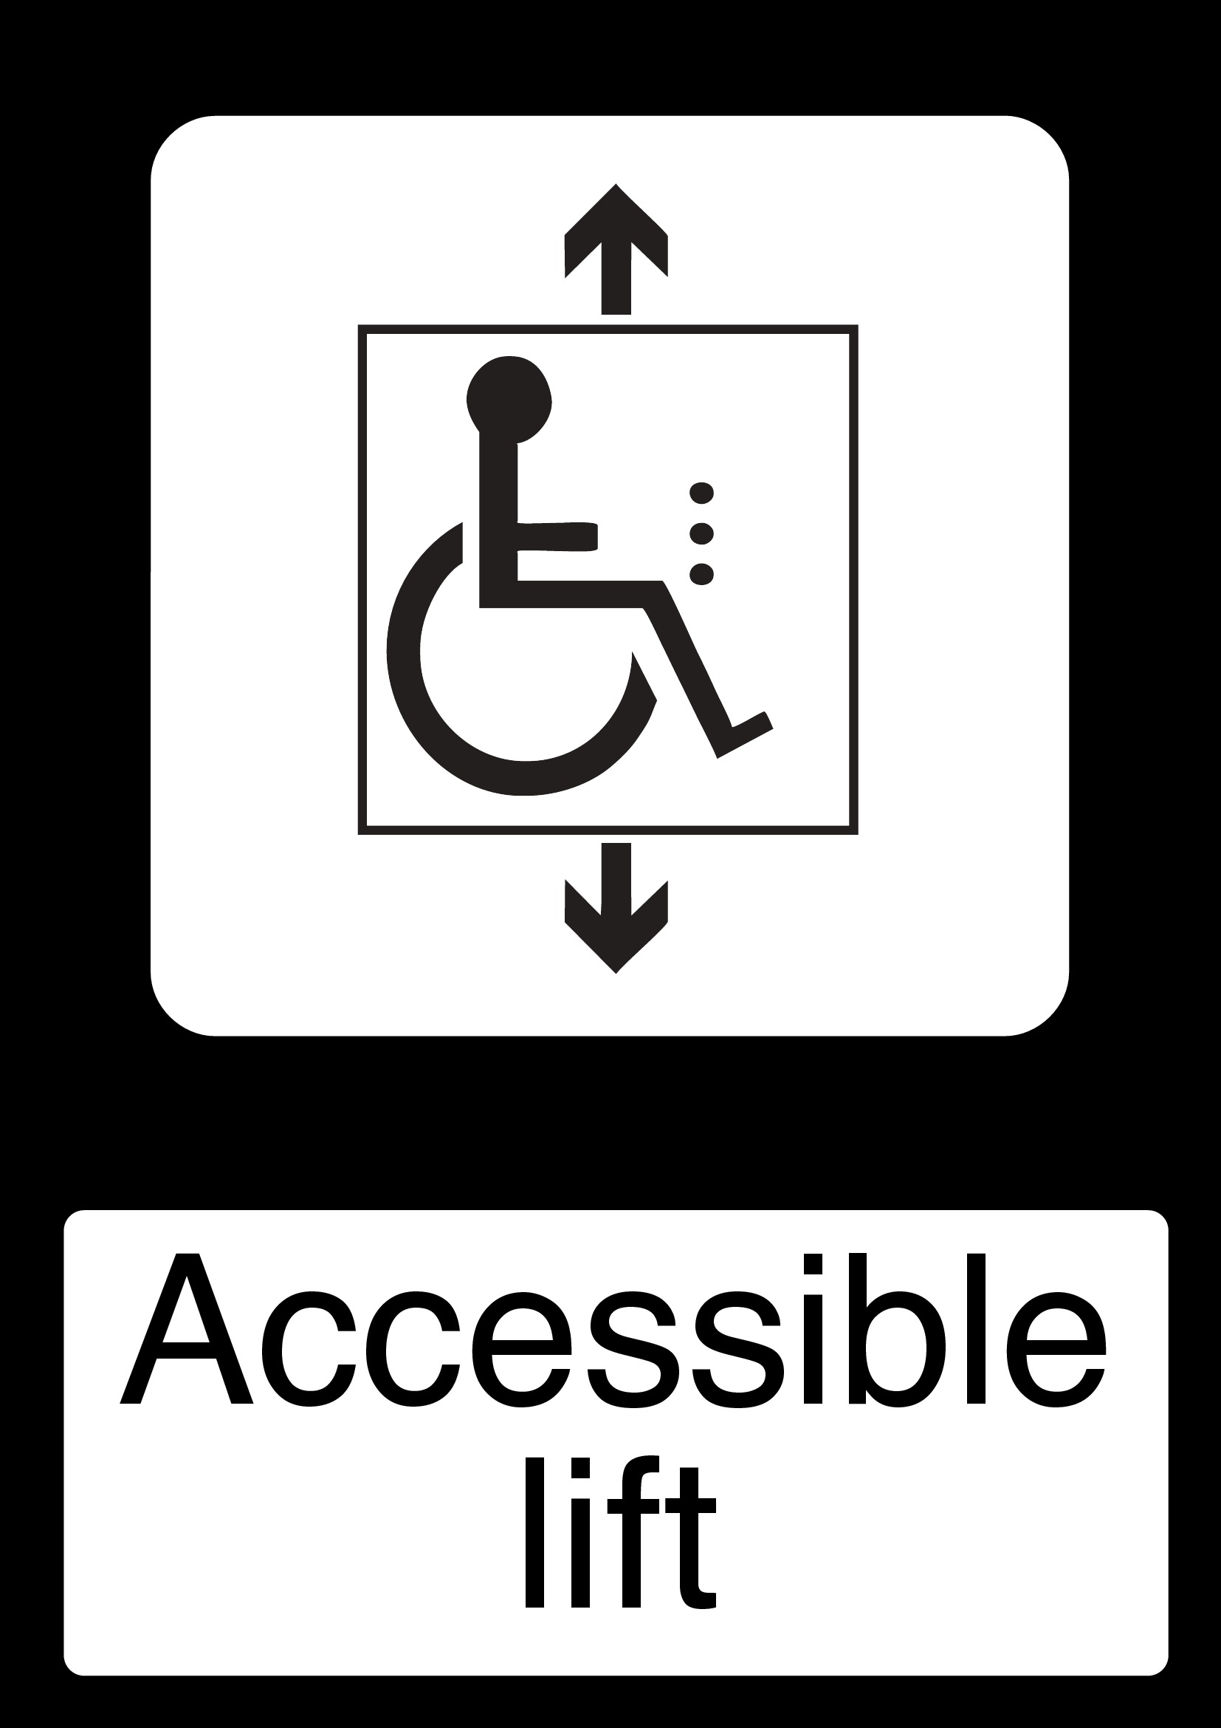






Slide 3
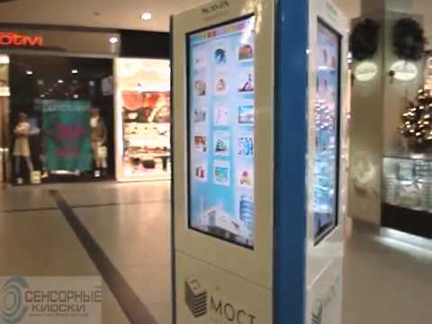
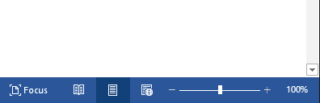
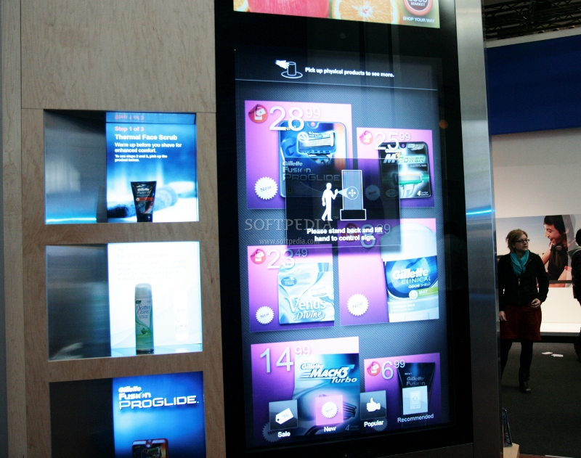

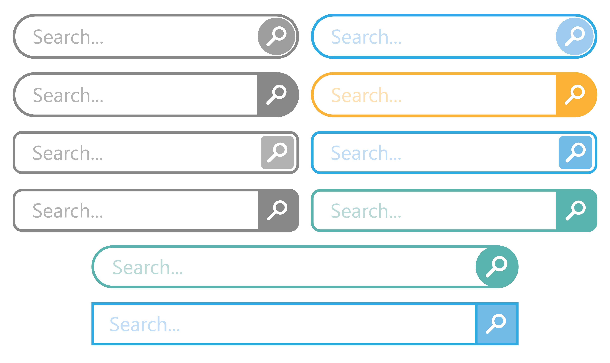


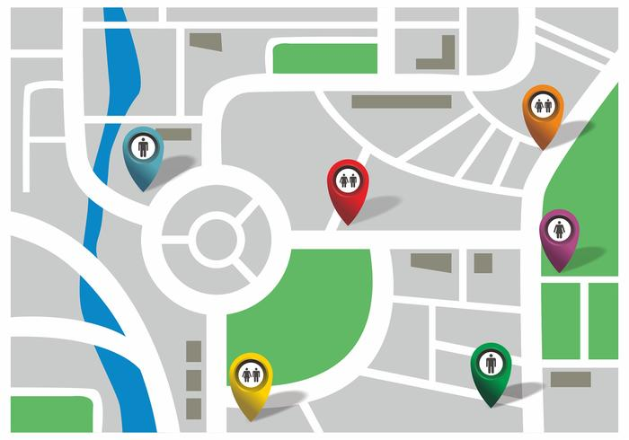

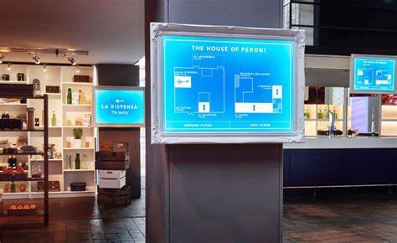


Slide 4
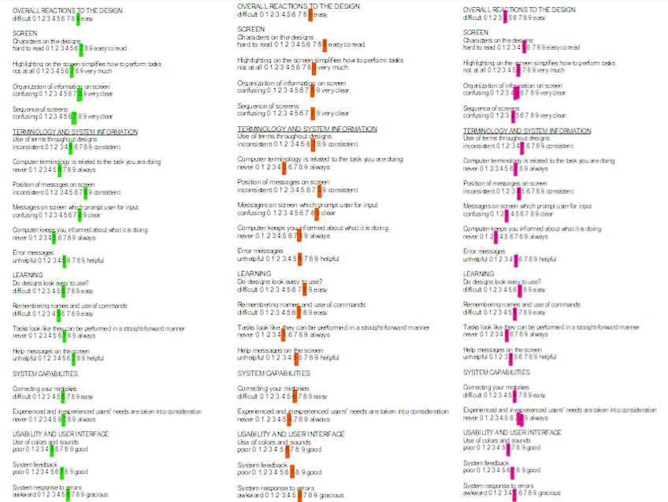

Slide 5
Client 1
Question number | Question | Rating 1- 5 (1 = difficult, 5 = easy)
1 | Overall response to interface design | 5
2 | User compatibility and accessibility | 5
3 | Features of program usage | 5
4 | Guidance and help | 5
5 | Feedback from program | 5

Slide 6
Client 2
Question number | Question | Rating 1- 5 (1 = difficult, 5 = easy)
1 | Overall response to interface design | 4
2 | User compatibility and accessibility | 4
3 | Features of program usage | 4
4 | Guidance and help | 5
5 | Feedback from program | 5

Slide 7
Client 3
Question number | Question | Rating 1- 5 (1 = difficult, 5 = easy)
1 | Overall response to interface design | 3
2 | User compatibility and accessibility | 5
3 | Features of program usage | 4
4 | Guidance and help | 5
5 | Feedback from program | 2

Slide 8
Client 4
Question number | Question | Rating 1- 5 (1 = difficult, 5 = easy)
1 | Overall response to interface design | 5
2 | User compatibility and accessibility | 5
3 | Features of program usage | 5
4 | Guidance and help | 5
5 | Feedback from program | 5

Slide 9
Client 5
Question number | Question | Rating 1- 5 (1 = difficult, 5 = easy)
1 | Overall response to interface design | 2
2 | User compatibility and accessibility | 3
3 | Features of program usage | 3
4 | Guidance and help | 4
5 | Feedback from program | 3

Slide 10
Click here​
Click here
lo
logo
User receives a main menu from which they may access any app.
The kiosk is not being used by anyone; thus, it is advertising a store's shop instead.
When a customer touches the sign, the sign comes to life and becomes interactive.
Main menu :
Parking
Shops
Exits
help
info
Main menu :
Parking
Shops
Exits
help
info
Click here​
search
Any choice can be made by the user from the menu tab.
Customers can use the search box to find items by performing additional searches.
If no action is taken after 45 seconds, the advertisement will reload and state, "Click to start."

Slide 11
Click here​
Main menu :
Parking
Shops
Exits
help
info
lo
logo
lo
logo
map
The user will select an option.
A 3d map will show the layout of the area
Opening and closing times will appear when selected
lo
lo
logo
lo
logo
logo
Click here​
User can click on the arrow to move around the map freely
User can use arrows on side to zoom in or out
Useful offers will show up Aswell as the opening and closing times

Slide 12
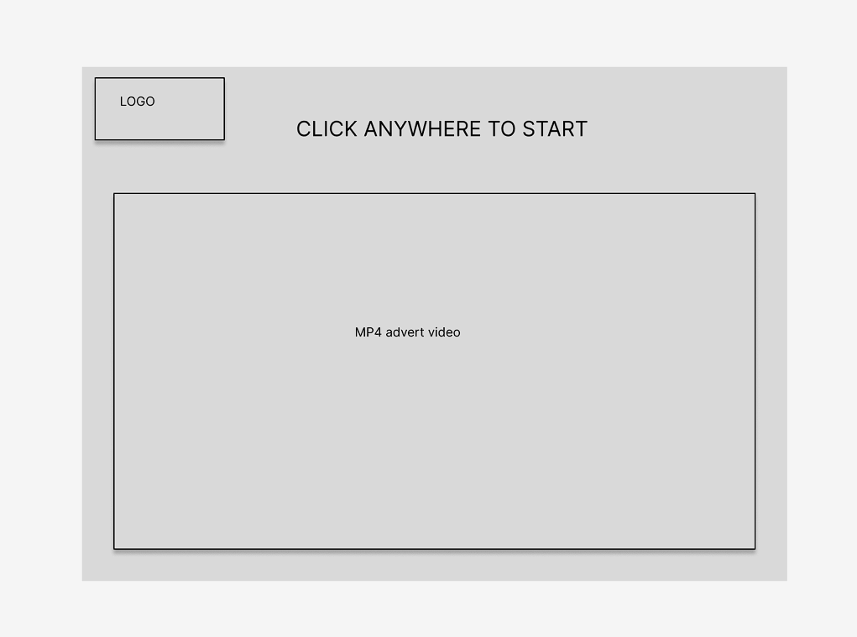
Logo of machine software
This sign will tell the customers they can click anywhere to start navigating
This area will be playing a looped video with audio to promote any stores

Slide 13
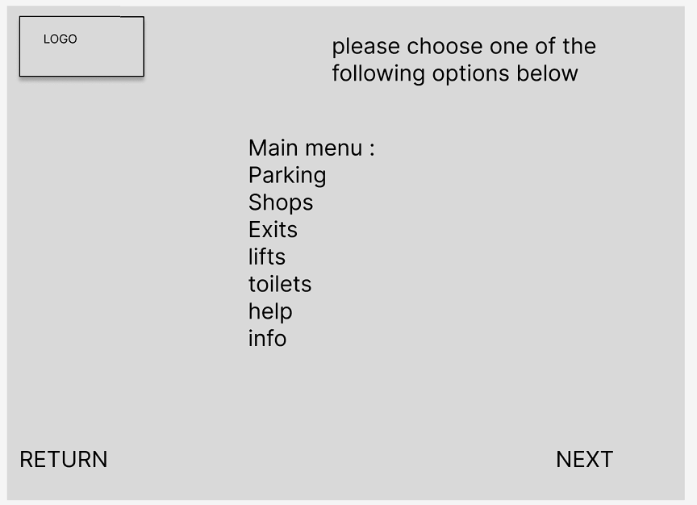
Logo of machine software
Text message for guidance
Interactive drop-down menu which will let user select one option and highlight chosen option
Search bar will allow user to enter their search and will display keyboard and mic
Search bar
User interactive button to allow them to move onto next step
User interactive button to go back

Slide 14
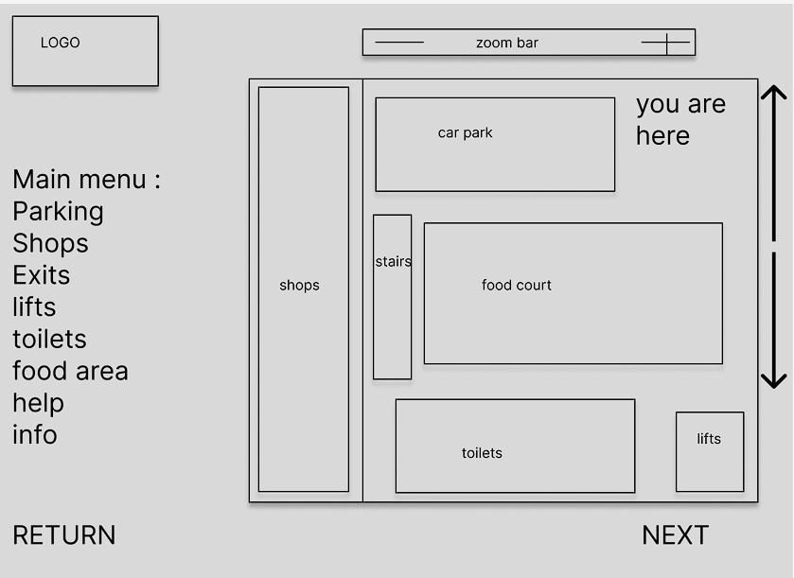
User interactive zoom in and out bar
Logo of machine software
User interactive button to allow them to navigate up and down
Interactive drop-down menu which will let user select one option and highlight chosen option
User interactive button to allow them to move onto next step
User interactive button to go back

Slide 15
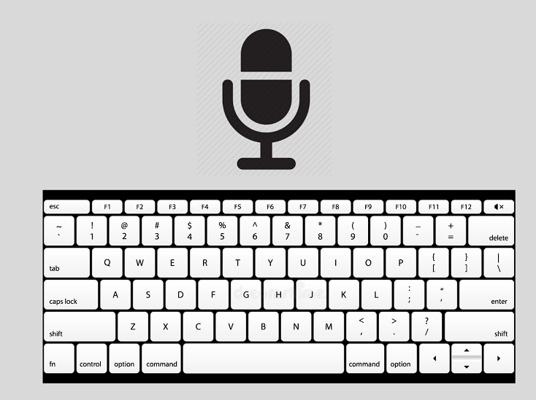
Interactive icon allows user to speak into machine
Interactive icon displays a keyboard which users can type through

